Slide 1
TEXT RECOGNITION
CSS 487 COMPUTER VISION
Professor: Dr. Clark F. Olson
Group members:
Andrew Chou
Nguyen Vi Cao
Yuze Wang

Slide 2
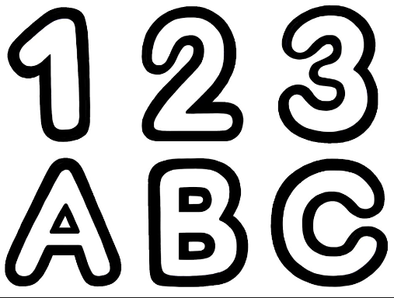
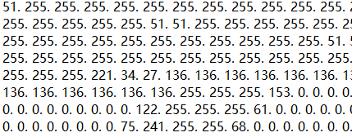
Brief introduction:
Use KNN algorithm to convert font image to matrix.
Tell the program which is which.
Use it to compare with the user input image.
Use many fonts.
KNN/K-nearest neighbors algorithm:
Similar to the k means cluster

Slide 3
Purpose:
Precondition: ideally, the program will read in a characters image
Postcondition: it will locate and identify each characters in that image and write the output to the console

Slide 4
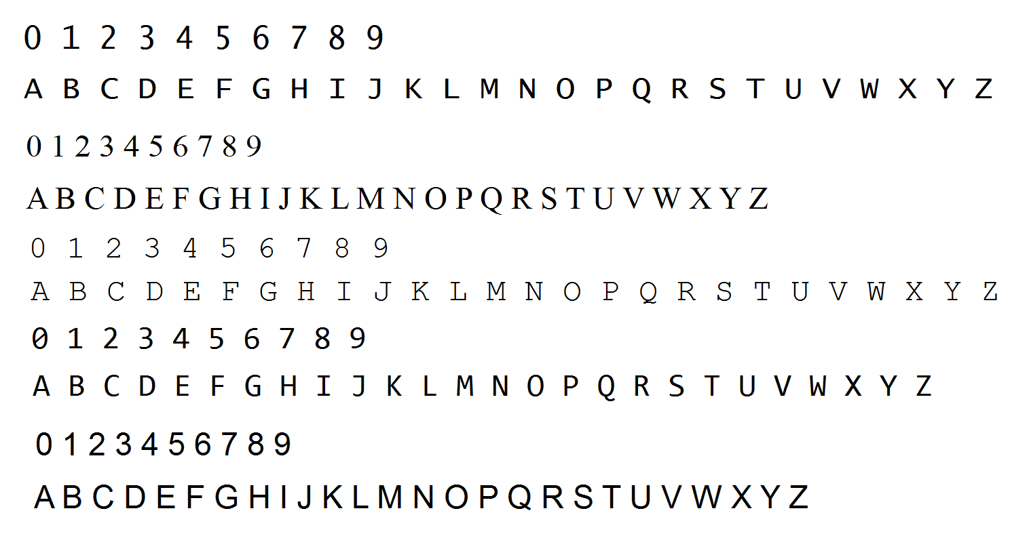
Approach:
Training data:
we will input an image that includes characters A-Z, 0-9 in different fonts and use opencv library to extract each characters.
Input Image for Training

Slide 5


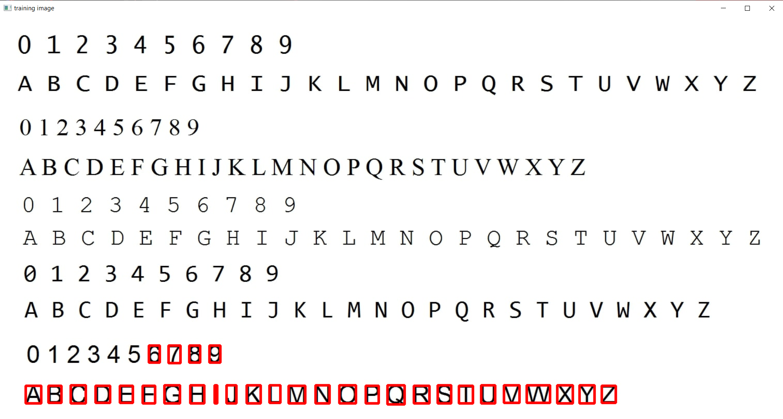
Approach:
Training data (Continue):
When we run the training program, it will first scan the input image (font image), and pop up three different windows on the screen which are ROI windows, Resized windows and Training Image windows respectively.
ROI is of 10 * 10 pixels
Resize is of 20 * 30 pixels
Based on the ROI windows, press the corresponding character shown. Once we pressed the key, red rectangular box will be shown on that character on original scanning image. This represents that the program has recognize this character shape.
d
ROI Window (10 x 10)
Resize Window (20 x 30)
Original Image Window (With some letter pressed)

Slide 6
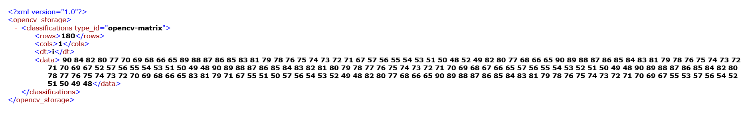
Approach:
Training data (Continue):
Once all the character has been pressed, the program will store those in ASCII character and save them into storage file (.xml file).
The Storage file will be used further in the testing phase to determine any hidden character within an image.
.xml file contents: Each number is decimal representation of one ASCII Character.
Notes:
ASCII: 90-Z; 84-T; 82-R; 80-P; 77-M; 70-F; 69-E

Slide 7
Approach:
2. Testing:
Read test input image, identify and compare the pattern using KNN algorithm to find the best match with the test image, if it matches, output the according ASCII
We expect the output for this image will be:
123ABC
Notes:
Hence KNN can be useful, especially in cases where the relationship between the input data and the result is unusual or very complex, which means that classic methods such as linear or logistic regression may not be able to do the job.

Slide 8
Conclusion:
Finished Part 1: Training and get storage files
What’s next? → Working on creating test class and perform basic image text recognition testing.
Q&A

